Slide 1
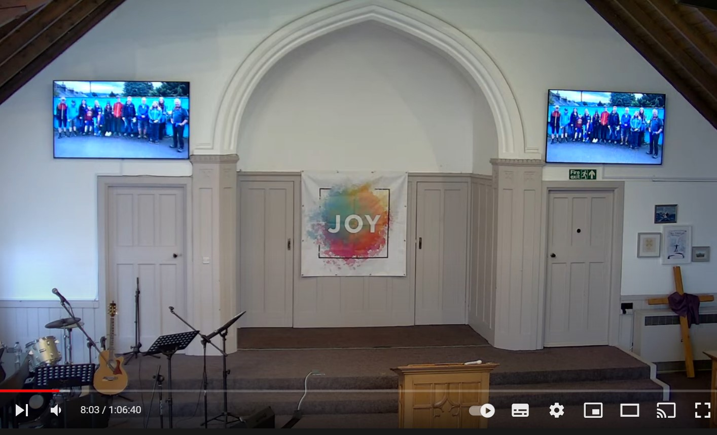
Livestream & Zoom Camera Feeds
Our morning service is livestreamed each week, with cameras feeding zoom and YouTube threads in our gathering together. We do this as part of enabling others to gather for worship in the best ways that they feel able to. There are subtitles provided within the zoom feed and you are welcome to use those within the sanctuary also if it is helpful by logging in – just keep the volume muted!
There are normally two cameras which focus primarily on the platform area but these will seek to follow the speaker and those leading the service. If you are on the platform you will be within the camera range for livestream/zoom, and those within the front two rows may on occasion appear, when standing, or in any interactive work.
The livestream video is on our YouTube channel for approximately three weeks after recording. A video podcast of the message only remains up subsequent to this.
If you have any questions or concerns please contact us at hello@cathcartbaptist.online or speak to the minister, contact mob. 07511 699805, or to those in the safeguarding group (details on notice board at front).

